Slide 1
Soft and Hard Hybrid Modelling for Insurance Cost Prediction
Student name
Palla Ramya

Slide 2

Project Background
Focus on predicting insurance costs using machine learning
Explore hybrid modeling: soft and hard voting-based methods
Combines strengths of individual base models
Evaluates performance using standard regression metrics (R², MAE, RMSE)

Slide 3
Research Aim
The aim of this project is to develop and compare soft and hard hybrid machine learning models to predict insurance costs, in order to identify which hybrid approach offers better generalization and predictive performance on structured insurance data.

Slide 4

Research Question
Which hybrid approach—soft combination (Probability based) or hard combination voting based)—yields better generalization and performance in insurance prediction?

Slide 5
Research Objectives
To perform EDA to identify key patterns and features influencing insurance charges
To build and assess base models (Decision Tree, Random Forest, Gradient Boost) for benchmark performance
To develop soft hybrid models using weighted averaging
To construct hard hybrid models using majority voting
To compare soft vs hard hybrid models using R², MAE, and RMSE
To assess robustness and applicability of hybrid models in real-world insurance scenarios

Slide 6
Motivation
Accurate insurance cost prediction is vital for pricing and risk assessment
Hybrid models offer potential performance improvement over single models
Growing interest in ensemble learning techniques in applied machine learning
Real-world relevance in health and life insurance sectors

Slide 7
Literature Review Summary
Regression and Ensemble Models
Study | Models Used | Best Result | Insight
Panda et al. (2022) | Polynomial, Lasso, Ridge, Linear | Polynomial: R² = 0.80 | Polynomial performed best
Patra et al. (2024) | KNN, Lasso, Ridge, XGBoost | XGBoost: R² = 86.81 | XGBoost outperformed others
ul Hassan et al. (2021) | SGB, XGBoost, RF, SVR, LR, KNN | SGB: Accuracy = 86% | Ensemble models showed better accuracy
Shyamala Devi et al. (2021) | Polynomial, RF, Linear | Polynomial: R² = 88% | Region not important; ensembles strong

Slide 8
Literature Review Summary
Hybrid and Big Data Approaches
Study | Method | Best Result | Insight
Wilson et al. (2024) | GLM, ANN, Hybrid (GLM-ANN) | Hybrid: MAE = 2011.9 | Hybrid model gave best results
Bhargavi and Arumugam (2024) | Hybrid (LR + Deep Belief Network) | Low error: 0.4926 | Captured both linear & complex patterns
Albalawi et al. (2023) | PySpark GBT, Polynomial | GBT: R² = 0.9067 | Big data tools improved performance

Slide 9
Project Requirements
Dataset: insurance.csv from GitHub (Machine-Learning-with-R-datasets)
Tools: Python, Pandas, NumPy, Scikit-learn, Matplotlib, Seaborn
Environment: Jupyter Notebook or Google Colab
Evaluation Metrics: R² Score, MAE, RMSE
Version Control: GitHub repository

Slide 10

Data Management Plan
Public dataset with features: age, sex, BMI, children, smoker, region, charges
No personally identifying information
Stored in secure university cloud with daily backups
Code and version control via GitHub
Complies with ethical use of open data
Citation: B. Lantz, Machine Learning with R, Packt Publishing, 2013

Slide 11
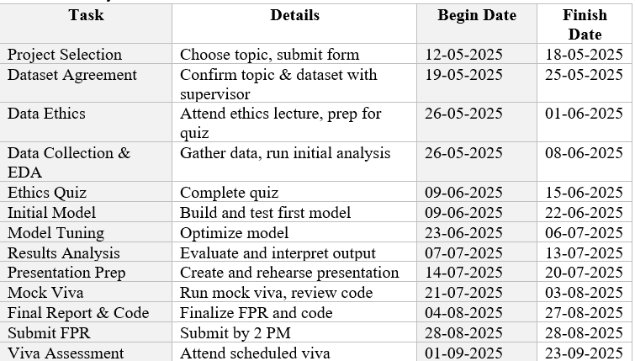
Task List

Slide 12
Timeline

Slide 13
Models Selected
Base Models:
o Decision Tree Regressor – interpretable baseline
o Random Forest Regressor – reduces overfitting via bagging
o Gradient Boosting Regressor – captures complex patterns through boosting
Hybrid Models:
o Soft Voting Regressor – uses weighted average of base predictions
o Hard Voting Regressor – uses majority voting after converting outputs into bins
Why These Models?
o Strong balance between performance and interpretability
o Proven effectiveness on structured/tabular data
o Well-suited for ensemble and hybrid learning experiments

Slide 14
Steps Included in the Project
Dataset loading and cleaning
Exploratory Data Analysis (EDA)
Base model implementation
Soft and hard hybrid model development
Model evaluation and comparison
Interpretation and result visualization

Slide 15
Work Completed So Far
Completed data preprocessing and encoding
Performed EDA on age, charges, BMI, smoker status
Implemented Decision Tree and Random Forest regressors
Visualized initial performance metrics

Slide 16
Work Remaining
Build and tune Gradient Boosting Regressor
Develop soft voting hybrid model
Develop hard voting hybrid model
Evaluate all models using R², MAE, RMSE
Final comparative analysis and documentation

Slide 17
Conclusion
Compared soft and hard hybrid strategies for predicting insurance costs
Targeted identifying the more effective ensemble technique
Built a reproducible framework using open data
Offers valuable insights for insurance analytics and ML model design

Slide 18
References
Panda, S., Purkayastha, B., Das, D., Chakraborty, M. and Biswas, S.K., 2022, May. Health insurance cost prediction using regression models. In 2022 International conference on machine learning, big data, cloud and parallel computing (COM-IT-CON) (Vol. 1, pp. 168-173). IEEE.
Patra, G.K., Kuraku, C., Konkimalla, S., Boddapati, V.N., Sarisa, M. and Reddy, M.S., 2024. An Analysis and Prediction of Health Insurance Costs Using Machine Learning-Based Regressor Techniques. Journal of Data Analysis and Information Processing, 12(4), pp.581-596.
AbdElminaam, D.S., Farouk, M., Shaker, N., Elrashidy, O. and Elazab, R., 2024. An Efficient Framework for Predict Medical Insurance Costs Using Machine Learning. Journal of Computing and Communication, 3(2), pp.55-64.
ul Hassan, C.A., Iqbal, J., Hussain, S., AlSalman, H., Mosleh, M.A. and Sajid Ullah, S., 2021. A computational intelligence approach for predicting medical insurance cost. Mathematical Problems in Engineering, 2021(1), p.1162553.
Albalawi, S., Alshahrani, L., Albalawi, N., Alharbi, R. and Alhakamy, A.A., 2023. Prediction of healthcare insurance costs. Computers and Informatics, 3(1), pp.9-18.
Wilson, A.A., Nehme, A., Dhyani, A. and Mahbub, K., 2024. A Comparison of Generalised Linear Modelling with Machine Learning Approaches for Predicting Loss Cost in Motor Insurance. Risks, 12(4), p.62.
Bhargavi, R. and Arumugam, S., 2024. Predictive Analytics in Healthcare: A Hybrid Model for Efficient Medical Cost Estimation for Personalized Insurance Pricing.
Shyamala Devi, M., P. Swathi, M. Purushotham Reddy, V. Deepak Varma, A. Praveen Kumar Reddy, Saranya Vivekanandan, and Priyanka Moorthy. "Linear and ensembling regression based health cost insurance prediction using machine learning." In Smart Computing Techniques and Applications: Proceedings of the Fourth International Conference on Smart Computing and Informatics, Volume 2, pp. 495-503. Springer Singapore, 2021.

Slide 19
Thank You

